Slide 1
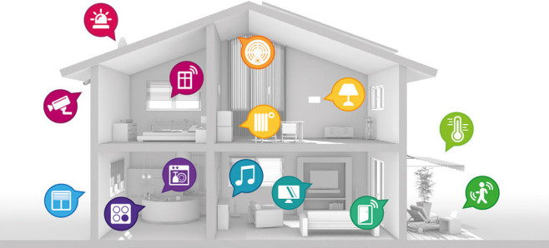
Secure Communication in Smart Home System
12/15/16
Robert-Octavian Popescu - 85720
Torben Lammers - 85884
Mathias Meuleman - 85885
Key Distribution + Authentcation
Protocol
Architecture

Slide 2
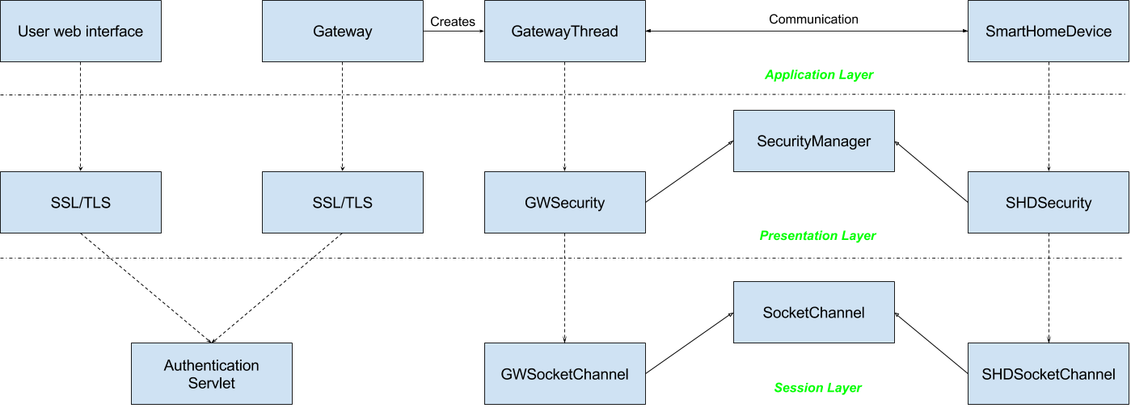
Architecture

Slide 3
Protocol

Slide 4
Security measures
Firewall
Timestamps

Slide 5
Demo

Slide 6

Thank you for your attention!

Slide 7
Sources of pictures
https://pt.wikipedia.org/wiki/Instituto_Superior_T%C3%A9cnico
http://www.computerbild.de/artikel/cb-News-PC-Hardware-Telekom-Drei-neue-Smarthome-Pakete-fuer-Qivicon-Sicherheut-Energiesparen-11044875.html
http://www.socialmediaminder.com/tag/questions/

Slide 8
System Overview
Smart Home Device
User
Gateway
Smart Home Device
User
Smart Home Device

Slide 9
Threats and countermeasures
S
Authentication
T
Encryption
R
Not handled
I
D
E
Not a threat
Encryption
Firewall on router

